Slide 1

UNIVERSITY INSTITUTE OF ENGINEERING
DEPARTMENT OF AIT - CSE
Bachelor of Engineering (CSE)
Security and Data Privacy Laws and Standards (21CSF-433)
By: Ms. Merry K.P(E12903)
Assistant Professor
AIT CSE
Lecture-13
Information Law, Rights of Employer Security
DISCOVER . LEARN . EMPOWER

Slide 2
Chapter | Course Objectives
1.3 | Understand the unique challenges posed to law enforcement agents, policy makers and prosecutors
Chapter | Course Outcomes
1.3 | After completion of this course, the student will be able to Describe the legal requirements for the use of Trusted data, data collection, and storage.

Slide 3
Contents
1.3 Legal, Privacy and Ethical Issues in Computer Security
Information and law
Rights of Employer Security
Case Study Ethics (DOS Attack)

Slide 4
Information and law
Information like source code, object code, and even the "look and feel" of a computer screen are recognizable, if not tangible. The information law deals with these things.
Some of the new challenges added to the legal systems like E-commerce, E-publishing, E-voting, electronic banking.
It requires some security information like,
Information as an object
Information is not depletable
Information can replicate
Information has a minimal marginal cost

Slide 5
IT Act 2000
Section | Offence | Penalty
65 | Tampering with computer source documents | Imprisonment up to three years, or/and with fine up to ₹200,000
66 | Hacking with computer system | Imprisonment up to three years, or/and with fine up to ₹500,000
66B | Receiving stolen computer or communication device | Imprisonment up to three years, or/and with fine up to ₹100,000
66C | Using password of another person | Imprisonment up to three years, or/and with fine up to ₹100,000
66D | Cheating using computer resource | Imprisonment up to three years, or/and with fine up to ₹100,000
66E | Publishing private images of others | Imprisonment up to three years, or/and with fine up to ₹200,000
66F | Acts of cyberterrorism | Imprisonment up to life.
67 | Publishing information which is obscene in electronic form. | Imprisonment up to five years, or/and with fine up to ₹1,000,000
67A | Publishing images containing sexual acts | Imprisonment up to seven years, or/and with fine up to ₹1,000,000

Slide 6
Cont…
Section | Offence | Penalty
67B | Publishing child porn or predating children online | Imprisonment up to five years, or/and with fine up to ₹1,000,000 on first conviction. Imprisonment up to seven years, or/and with fine up to ₹1,000,000 on second conviction.
67C | Failure to maintain records | Imprisonment up to three years, or/and with fine.
68 | Failure/refusal to comply with orders | Imprisonment up to 2 years, or/and with fine up to ₹100,000
69 | Failure/refusal to decrypt data | Imprisonment up to seven years and possible fine.
70 | Securing access or attempting to secure access to a protected system | Imprisonment up to ten years, or/and with fine.
71 | Misrepresentation | Imprisonment up to 2 years, or/and with fine up to ₹100,000
72 | Breach of confidentiality and privacy | Imprisonment up to 2 years, or/and with fine up to ₹100,000
72A | Disclosure of information in breach of lawful contract | Imprisonment up to 3 years, or/and with fine up to ₹500,000
73 | Publishing electronic signature certificate false in certain particulars | Imprisonment up to 2 years, or/and with fine up to ₹100,000
74 | Publication for fraudulent purpose | Imprisonment up to 2 years, or/and with fine up to ₹100,000
Notes:
Section
Offence
Penalty
65
Tampering with computer source documents
Imprisonment up to three years, or/and with fine up to ₹200,000
66
Hacking with computer system
Imprisonment up to three years, or/and with fine up to ₹500,000
66B
Receiving stolen computer or communication device
Imprisonment up to three years, or/and with fine up to ₹100,000
66C
Using password of another person
Imprisonment up to three years, or/and with fine up to ₹100,000
66D
Cheating using computer resource
Imprisonment up to three years, or/and with fine up to ₹100,000
66E
Publishing private images of others
Imprisonment up to three years, or/and with fine up to ₹200,000
66F
Acts of cyberterrorism
Imprisonment up to life.
67
Publishing information which is obscene in electronic form.
Imprisonment up to five years, or/and with fine up to ₹1,000,000
67A
Publishing images containing sexual acts
Imprisonment up to seven years, or/and with fine up to ₹1,000,000
67B
Publishing child porn or predating children online
Imprisonment up to five years, or/and with fine up to ₹1,000,000 on first conviction. Imprisonment up to seven years, or/and with fine up to ₹1,000,000 on second conviction.
67C
Failure to maintain records
Imprisonment up to three years, or/and with fine.
68
Failure/refusal to comply with orders
Imprisonment up to 2 years, or/and with fine up to ₹100,000
69
Failure/refusal to decrypt data
Imprisonment up to seven years and possible fine.
70
Securing access or attempting to secure access to a protected system
Imprisonment up to ten years, or/and with fine.
71
Misrepresentation
Imprisonment up to 2 years, or/and with fine up to ₹100,000
72
Breach of confidentiality and privacy
Imprisonment up to 2 years, or/and with fine up to ₹100,000
72A
Disclosure of information in breach of lawful contract
Imprisonment up to 3 years, or/and with fine up to ₹500,000
73
Publishing electronic signature certificate false in certain particulars
Imprisonment up to 2 years, or/and with fine up to ₹100,000
74
Publication for fraudulent purpose
Imprisonment up to 2 years, or/and with fine up to ₹100,000

Slide 7
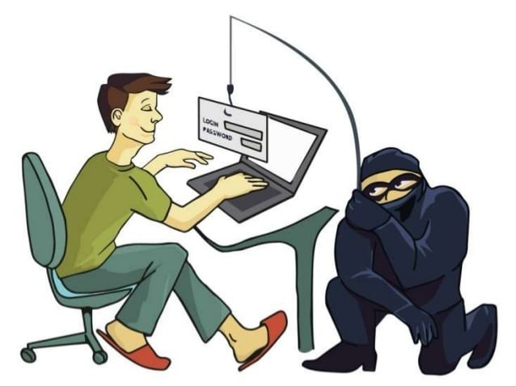
Phishing and Vishing
Phishing is a form of fraud in which an attacker masquerades as a reputable entity or person in email or other forms of communication. Attackers will commonly use phishing emails to distribute malicious links or attachments that can perform a variety of functions. Phishing is a punishable act, and it was amended in 2008 Information Technology Act, 2000, under section 66, 66A, 66C & 66D.
Vishing refers to phishing attacks that involve the use of voice calls, using either conventional phone systems or Voice over Internet Protocol (VoIP) systems.

Slide 8
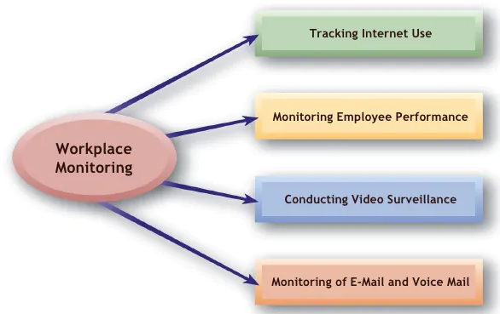
Rights of Employer Security

Slide 9
Cont…
The protection offered by copyrights, patents, and trade secrets appeals to employers because it applies to the ideas and products.
However, the issue of who owns the ideas and products is complex.
Ownership is a computer security concern because it relates to the rights of an employer to protect the secrecy and integrity of works produced by the employees.

Slide 10
Cont…
Some key terms to define the security of the employer,
Ownership of Products
Ownership of a Patent
Ownership of a Copyright
Licenses / Trademarks
Trade Secret Protection
Employment Contracts

Slide 11
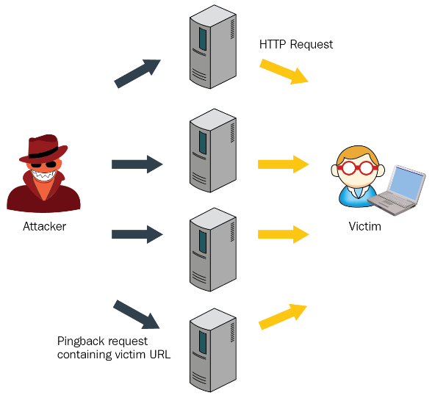
Case Study Ethics (DOS Attack) D-DOS

Slide 12
What Are Denial of Service Attacks?
A denial-of-service (DoS) attack is a tactic for overloading a machine or network to make it unavailable. Attackers achieve this by sending more traffic than the target can handle, causing it to fail—making it unable to provide service to its normal users. Examples of targets might include email, online banking, websites, or any other service relying on a targeted network or computer.
There are different types of DoS attacks such as resource exhaustion and flood attacks. Resource exhaustion attacks cause the targeted infrastructure to use all of its available memory or storage resources, slowing the service's performance or stopping it all together. Flood attacks send an overwhelming number of packets that exceed server capacity.
A distributed denial-of-service (DDoS) is a type of DoS attack where the traffic used to overwhelm the target is coming from many distributed sources. This method means the attack can't be stopped just by blocking the source of traffic.
Botnets are often employed for DDoS attacks.

Slide 13
Cont…
A Denial-of-Service (DoS) attack is meant to shut down a machine or network, making it inaccessible to its intended users.
DoS attacks accomplish this by flooding the target with traffic or sending it information that triggers a crash.
In both instances, the DoS attack deprives legitimate users (i.e., employees, members, or account holders) of the service or resource they expected.
There are two general methods of DoS attacks: flooding services or crashing services. Flood attacks occur when the system receives too much traffic for the server to buffer, causing them to slow down and eventually stop.

Slide 14
Types of DDoS Attacks
SMURF ATTACK
A smurf attack is a DDoS attack that sends packets spoofing the victim's source IP. When devices on the network attempt to respond, the amount of traffic slows the targeted device to the point of being unusable.
SYN FLOOD
A SYN flood attack opens many connections with the target server and then never closes them. The attacker, acting as a client, sends a SYN message. When the server responds with a SYN-ACK, the malicious client never sends an ACK message. In this way the server is forced to keep numerous connections open, taxing it's resources until it fails.
LAYER 7 DDOS ATTACK
A Layer 7 DDoS attack (or application attack) targets a specific service instead of an entire network. These are becoming increasingly more common than broad network attacks.

Slide 15
Protection Against Denial of Service Attacks
While DoS attacks are less challenging to stop or prevent, DDoS attacks can still present a serious threat.
Prevent spoofing: Check that traffic has a source address consistent with the set of addresses for its stated site of origin and use filters to stop dial-up connections from spoofing.
Limit broadcasting: Often attacks will send requests to every device on the network, amplifying the attack. Limiting or turning off broadcast forwarding where possible can disrupt attacks. Users can also disable echo and chargen services where possible.
Streamline incident response: Honing your incident response can help your security team respond quickly when DoS attacks are detected.

Slide 16
Protection Against Denial of Service Attacks
Protect endpoints: Ensure that all endpoints are patched to eliminate known vulnerabilities. Endpoints capable of running EDR agents should have them installed.
Dial in firewalls: Ensure your firewalls are limiting ingress and egress traffic across the perimeter wherever possible.
Monitor the network: The more you know about what normal inbound traffic looks like, the quicker you'll spot the start of a DDoS attack. Real-time visibility with network detection and response (NDR) is an efficient and reliable way to maintain a profile of what your network should look like (using machine learning) so you can detect suspicious surges immediately.

Slide 17
Requirements
What is the additional information needed?
Who has rights in this case? What rights are those? Who has a responsibility to protect those rights? (This step in the ethical study is used to clarify who should be considered as the reference group for a deontological analysis.)

Slide 18
Summary
Importance information law & employer rights
Awareness about data protections
Importance rights of employer security
Balancing employer security and employee rights
Overview of ethics

Slide 19
Home Work
Q1. Why employer security is important in organization?
Q2. What do you mean by IT Act’2000?

Slide 20
References
Text Books:
V. D. Dudeja ,”Cyber Crime and Law Enforcement”, Commonwealth Publishers, 2003.
C. Davis,”IT Auditing: Using Controls to protect Information Assets”, TMH, 2011.
Reference Books:
Paul van Oorschot, computer Security and the Internet: Tools and Jewels (2020, Springer). Personal use copy freely available on author's web site.
Wenliang Du, Computer Security: A Hands-on Approach (2017, self-published). Updated May 2019.
Online References:
Employee and Employer Rights: https://www.youtube.com/watch?v=_M4q-xTLPAM
Data Protection in Software Development: https://www.youtube.com/watch?v=mxusGZtPLos

Slide 21
THANK YOU
For queries
Email: merry.e12903@cumail.in

